Slide 1

AI-Powered Disease Prediction System
HEALTHCARE TECHNOLOGY
Team Name: Tech Titans
Team Members:
KEERTHIKA S [2261027] KAVINESH C [2261026] GS SHREE LAKSHMI [2261016]
MISSION
CHRIST is a nurturing ground for an individual’s holistic development to make effective contribution to the society in a dynamic environment
VISION
Excellence and Service
CORE VALUES
Faith in God | Moral Uprightness Love of Fellow Beings
Social Responsibility | Pursuit of Excellence

Slide 2
Introduction
CHRIST
Deemed to be University
AI-Powered Disease Prediction System
A web-based application for predicting diseases based on symptoms
Utilizes simple checkboxes for symptom input Provides immediate predictions and descriptions

Slide 3
Problem Statement
CHRIST
Deemed to be University
Challenges in Early Disease Detection
Delayed diagnosis can lead to severe health issues
Limited access to healthcare professionals in some areas
Need for accessible, quick, and reliable prediction tools

Slide 4
CHRIST
Deemed to be University
Proposed Solution
AI-Powered Disease Prediction System
Users select symptoms via checkboxes
Predicts possible diseases based on input
Provides brief descriptions of predicted diseases

Slide 5
System Design
System Architecture:
HTML Form: Collects user input (symptoms)
JavaScript: Processes input and predicts disease
CSS: Styles the form and result display
Table: Displays the prediction and description
Image: Visual representation of the system

Slide 6
Implementation Details
HTML Structure:
Form with checkboxes for symptoms
Submit button for prediction
CSS Styling:
Layout and design for user-friendly interface
Responsive and clean design
JavaScript Logic:
Processes user input
Predicts diseases based on symptoms
Display results dynamically

Slide 7
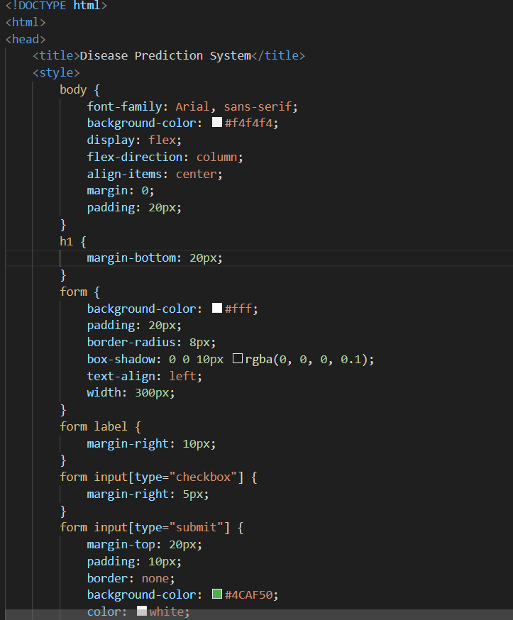
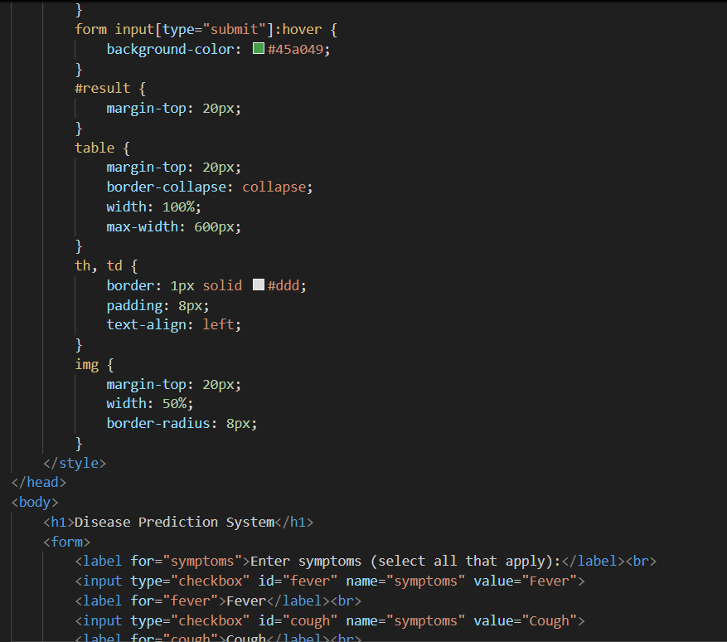
Demo

Slide 8
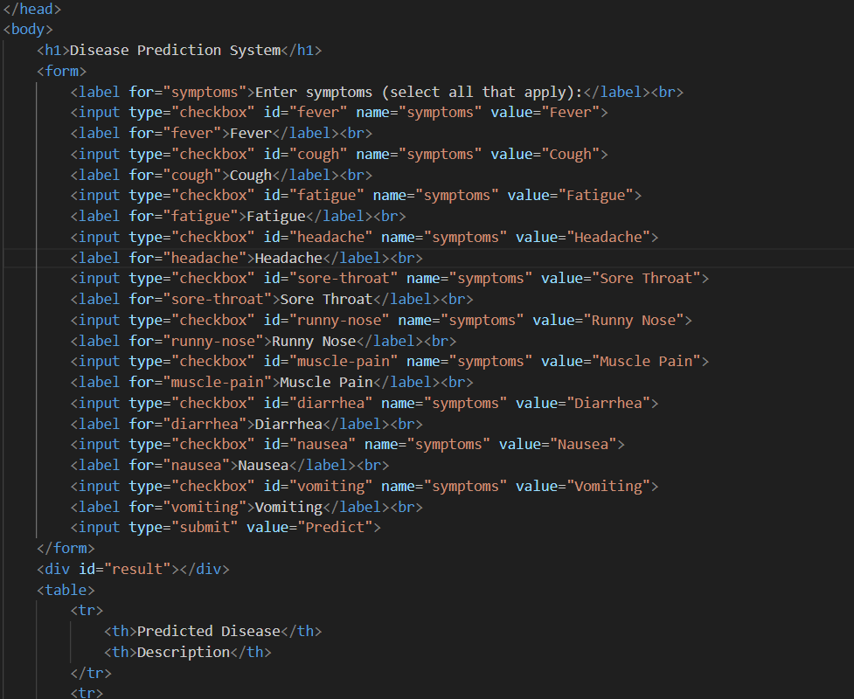
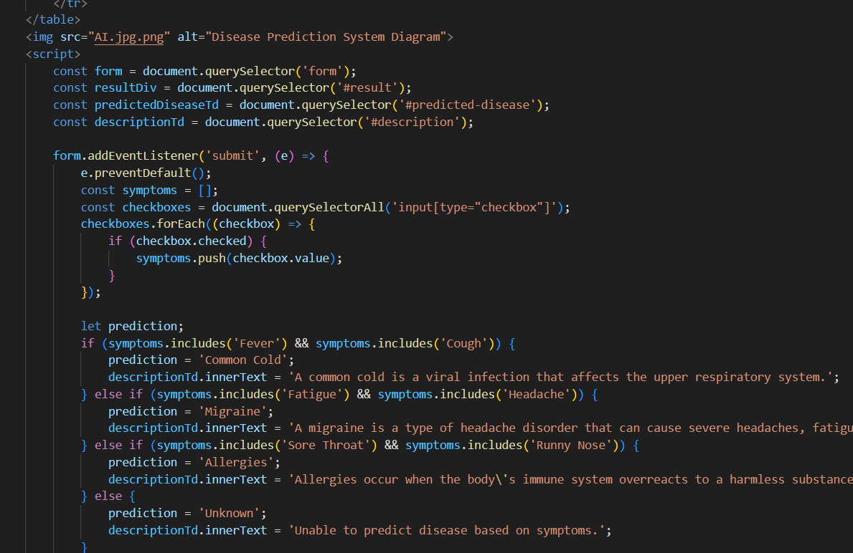

Slide 9
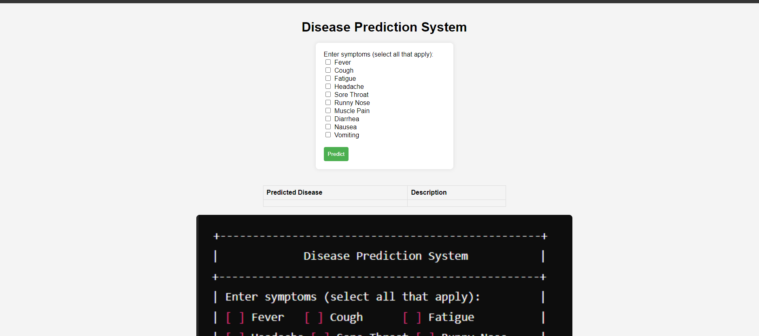
WEB PAGE:

Slide 10
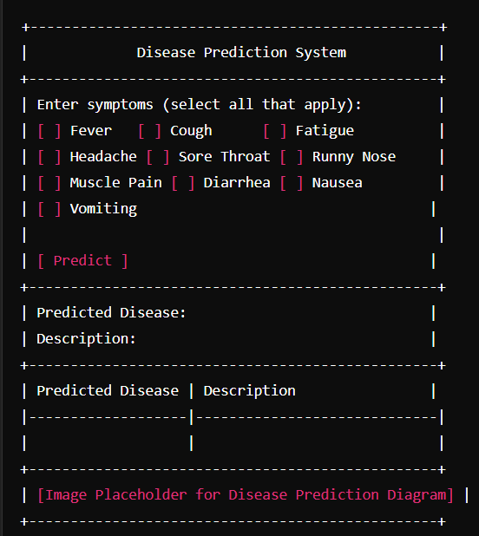
CODE FLOW:

Slide 11
Conclusion
Summary
A simple, accessible tool for disease prediction
Immediate feedback based on symptoms
Potential to expand with more diseases and symptoms
Future Improvements
Integration with medical databases for more accurate predictions
Enhanced user interface with more input options
Mobile app version for broader accessibility

Slide 12


